Slide 1














Airport
Hotel
Business Execs
Government Building
Representatives
City
Center
Conference Attendees

Slide 2















Gold Customers
Gold Queue
Silver Customers
Silver Queue
Customers
Routing Rules
Customers
Support Queue

Slide 3






Leveraging Queues
Case routed to gold queue
Case routed back to gold queue
Agent releases control of case
Gold customer
Contacts support via phone
Silver queue
Agent picks case from gold queue to work on
Case moved to agent’s personal queue
Agent resolves case
Support queue
Case resolved and removed from all queues

Slide 4
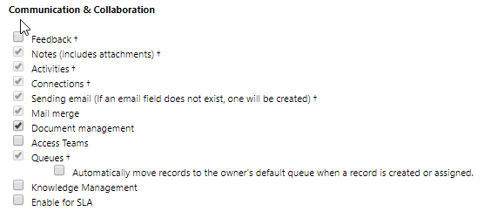
This option is useful if you want to ensure that a queue item will be automatically created and assigned.

Slide 5
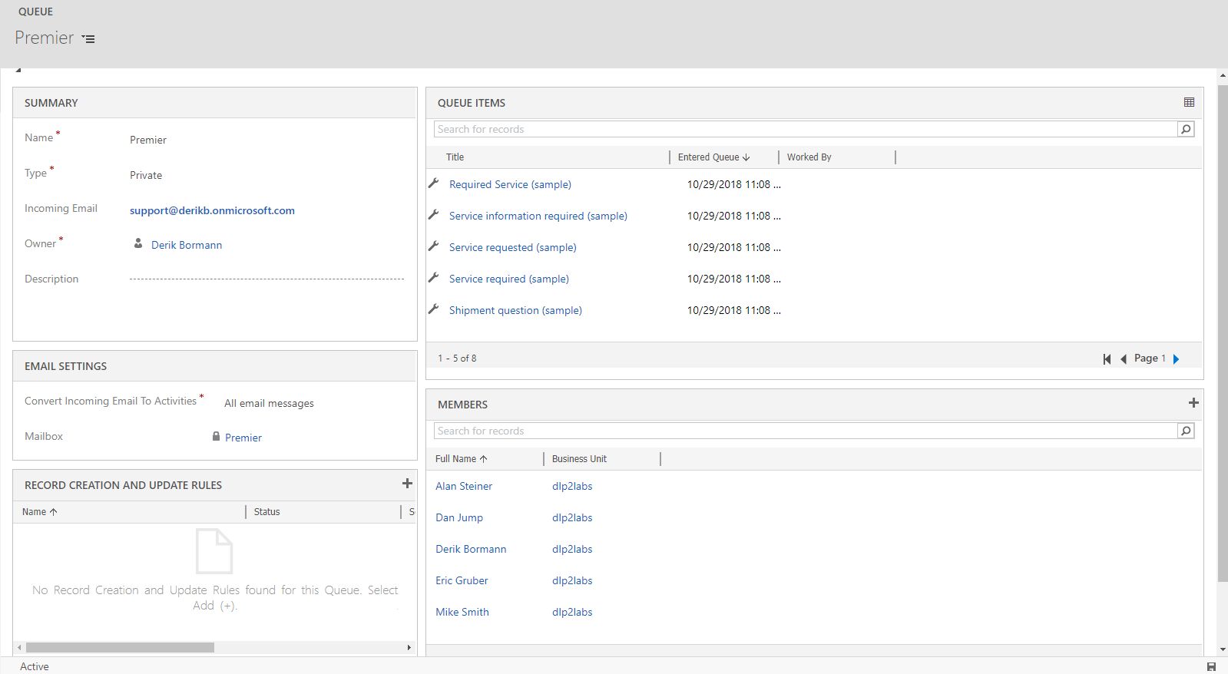
Email address used by queue for receiving email
Controls which emails are converted to email activities.
Displays all Queue Items that are currently associated with the queue.
Additional members can be added as needed
Record creation and update rules associated with the current queue will display here.
Displays a list of all members assigned to a private queue.
NOTE: Members cannot be added to public queues.

Slide 6









Using queues for lead management
Michigan Leads
Mike Smith’s Queue
Sales Manager
Ohio Leads
Incoming Leads
Julie Brown’s Queue
Incoming Leads
Minnesota Leads
Mark Anderson’s Queue

Slide 7









Routing Queue Items to specific Queues
Gold Customer
Case manually created
Agent selects Add to Queue
Agent selects the queue to route to
Silver Queue
Available Channels
Silver Customer
Case manually created
Agent selects Save & Route
Gold Queue
Customer
Routing rule routes case to appropriate queue
Case auto created
Support Queue

Slide 8
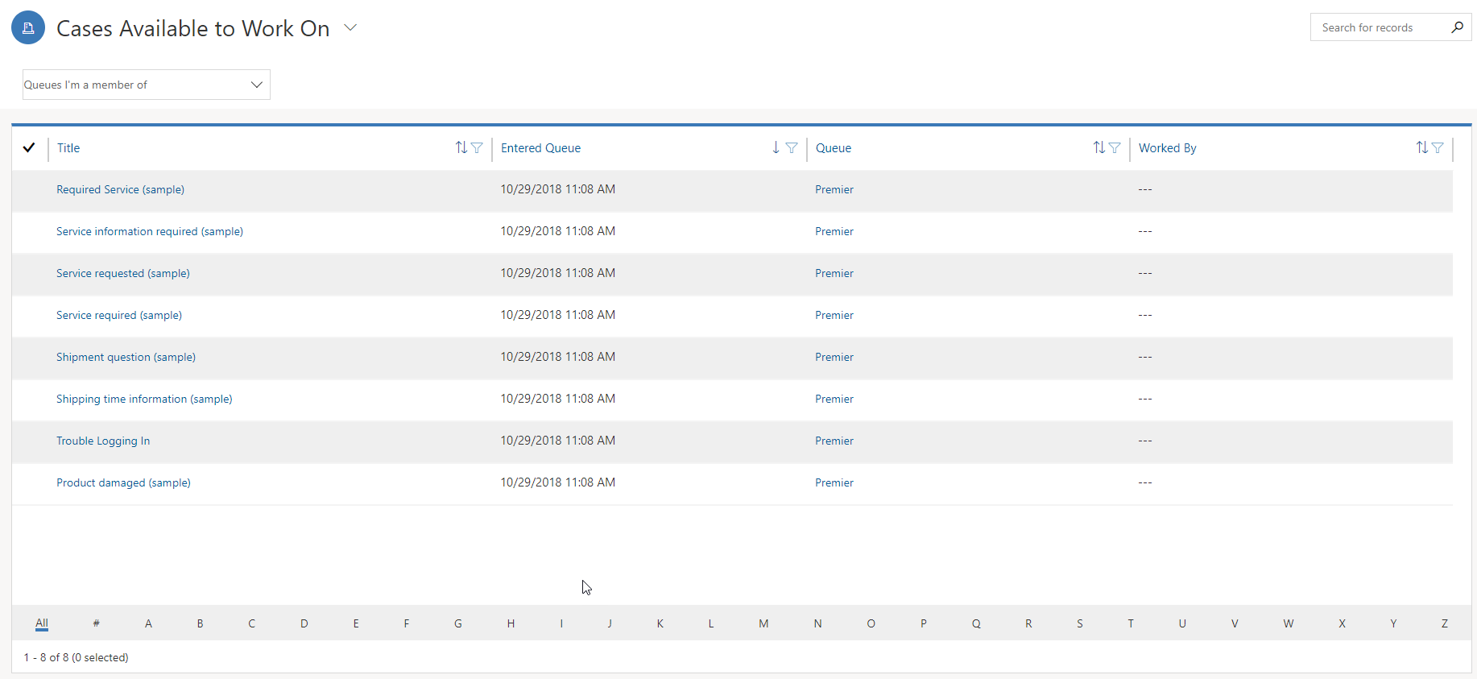
Queue Items drop-down:
Filters the list of Queue Item that displayed in view.
Queue Drop-Down:
Allows selection of a specific queue(s) that the queue Items filter is applied to.

Slide 9


Managing cases using queues
Agent removes queue item
Agent creates a new case
Agent selects Save and Route
Queue Item removed from all queues
Queue Item created
Or
Queue Item is moved to agent’s personal queue
Agent releases queue item
Or
Queue item routed back to gold queue
Agent picks queue item from gold queue to work on
Agent resolves case
Case resolved and queue Item removed from all queues
Gold Queue
Routing rule sends queue item to gold queue

Slide 10






Case Routing
Service Level = Gold
Gold Queue
Service Level = Silver
Case Routing Rule Set
Silver Queue
Cases
Service Level = Bronze
Bronze Queue

Slide 11
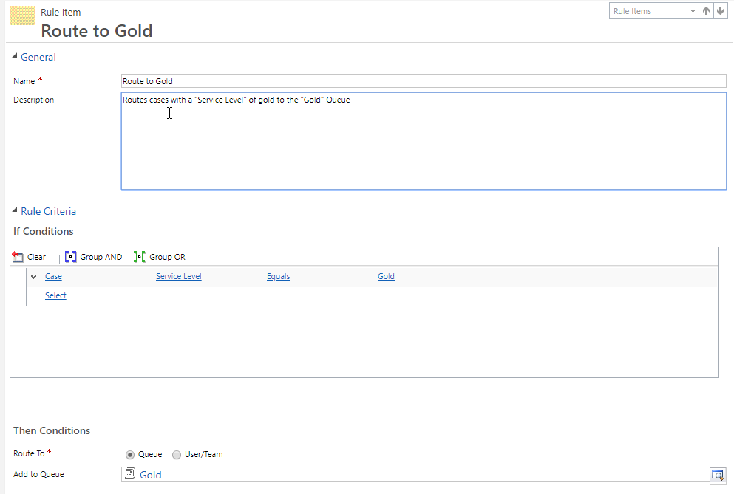
Conditions support AND / OR combinations.

Slide 12
Escalated
Service Level = Gold
Priority = High
Gold
Service Level = Gold
Silver
Service Level = Silver
Bronze
Service Level - Bronze

Slide 13
Case manually created
Agent selects Save & Route
Gold Queue
Routing rule routes case to appropriate queue
Case auto created
Support Queue

